Slide 1

How do we know it works?

Slide 2
One of Man’s Oldest Medications
Ancient Egyptians physicians used Colchicine to treat
their pharaohs. The first recognized use of this plant was by Alexander of Tralles, 6th century ancient Greece.

Slide 3
1763: Specificity for relief of gout was introduced by
Baron Von Storch
1780s : Ben Franklin first brings Autumn Crocus plants
(the plant that produces Colchicine)
from France to USA to treat his own gout.

Slide 4
1820: Scientists Pelletier & Cavent isolated the active compound – Colchicine from the Autumn Crocus
plant aka Meadow Saffron.
1940: In France first preparation of IV Colchicine becomes available.
1950: Colchicine becomes available in IV form in USA for treatment of acute, painful gout.

Slide 5
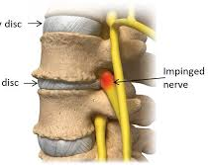
1953: Dr. Michael Rask MD makes a serendipitous discovery that IV Colchicine heals patients with disk disease.

Slide 6
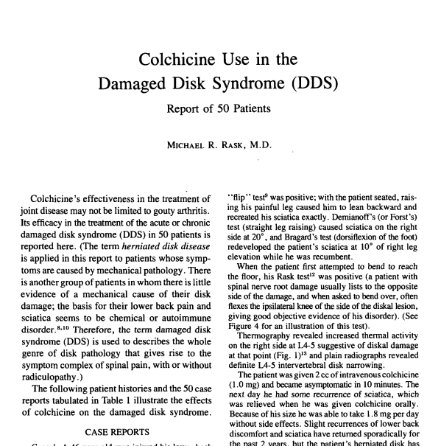

Slide 7
1979: Rask, M.R.” Colchicine Use In Disk Disorders:
Report Of 300 Patients” Journal Of Neurology & Orthopedic Medicine &Surgery 1:56-64,1979
1980: Rask, M.R. “Colchicine Use In 50 Patients With Disk Disorders” Journal of Neuro. &Orthopedic Medicine &Surgery
1:351 – 369, 1980.

Slide 8
1982: Meek,J.B. “CT Scan Of An Intervertebral Disk Before And After Successful Treatmen of Colchicine” J. Neuro. & Ortho. Med. & Surgery 3: 133 -136, 1982.
1985: Margoles, M.S. “New Idea For IV Colchicine Delivery” J. Neuro. & Ortho. Med.& Surgery 4: 83

Slide 9
1985: Rask, M.R. “Colchicine Use In 3000 Patients with Discal (and other) Painful Spinal Disorders”J. Neuro. &Ortho. Med. & Surgery 6: 296 -302,1985

Slide 10
1985: FDA STUDY PUBLISHED-SHOWING 92% SUCCESS
“ Colchicine Effective In Disk Disease Final Results Of A Double – Blind FDA Approved Study
(Number 21,807)”
Meek, J.D., Giudice
V.W. McFadden
J.W. Key
J.D., & Enrick N.L.

Slide 11
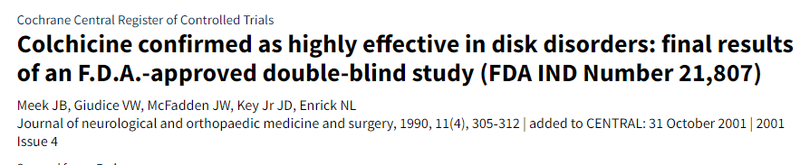

Slide 12
1989: Rask, M.R. “ Colchicine Use IN 6000 Patients With Disk Disease & Other Related Resistantly Painful Spinal Disorders “
J. Neuro.&Ortho. Med. & Surgery.

Slide 13
